Slide 1
Web Engineering Lab – 11

Slide 2
Databases with php
Most Web applications Retrieve information from a database to alter their on-screen display
Most Web applications store user data such as orders, tracking, address, credit card, etc. in a database.

Slide 3
Connect to MySQL
Before we can access data in the MySQL database, we need to be able to connect to the server
// Create connection $conn = new mysqli($servername, $username, $password);
// Check connection if ($conn->connect_error) { die("Connection failed: " . $conn->connect_error); }
//Close connection
$conn->close();

Slide 4
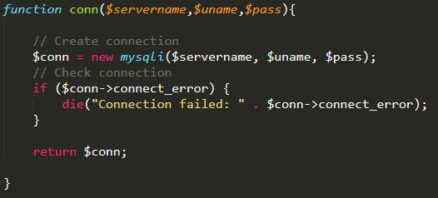
Connect to MySQL
Sample program:

Slide 5
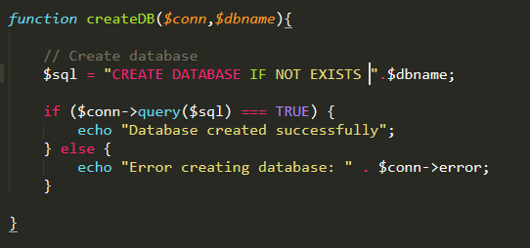
Create a MySQL Database
A database consists of one or more tables.
The CREATE DATABASE statement is used to create a database in MySQL.

Slide 6
Terminating script
PHP die() Function: Print a message and terminate the current script:
The die()and exit()functions terminate script execution
The die()version is usually used when attempting to access a data source
Both functions accept a single string argument
Call the die()and exit()functions as separate statements or by appending either function to an expression with the Or operator

Slide 7
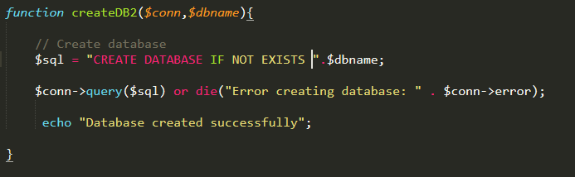
Create a MySQL Database
Example using OR :

Slide 8
Executing SQL statements
Use the query() function to send SQL statements to MySQL
The syntax for the query()function is: $conn->query($sql);
That is connection object is needed and
String sql query is passed as parameter
The query() function returns different values based on the query

Slide 9
Exercise – 20 mint
Create a Table product inside the “test” database:
prod_id (int) which is autoincrement and primary key
prod_nam (string) which should not be null
prod_price (int) which should not be null
Hint: create table product(prod_id int AUTO_INCREMENT PRIMARY KEY, prod_name varchar(50) not null, price int not null);

Slide 10
CRUD Operations
CRUD is an acronym for Create, Read, Update, and Delete.
CRUD operations are basic data manipulation for database.
We will learn how to perform create (i.e. insert), read (i.e. select), update and delete operations in php using simple examples.

Slide 11
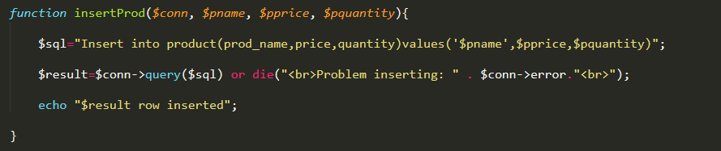
Inserting data
To add records to a table, use the INSERT and VALUES keywords with the query()function
You must specify NULL in any fields for which you do not have a value
Example:
$sql = ”INSERT INTO MyGuests (firstname, lastname, email) VALUES ('John', 'Doe', 'john@example.com')";

Slide 12
Inserting data
For multiple insert:
$sql = "INSERT INTO MyGuests (firstname, lastname, email) VALUES ('John', 'Doe', 'john@example.com');"; $sql .= "INSERT INTO MyGuests (firstname, lastname, email) VALUES ('Mary', 'Moe', 'mary@example.com');"; $sql .= "INSERT INTO MyGuests (firstname, lastname, email) VALUES ('Julie', 'Dooley', 'julie@example.com')";
Then use function: $conn->multi_query($sql)

Slide 13
Exercise – 20 mint
Insert data into this table

Slide 14
Updating data
To update records in a table, use the UPDATE, SET, and WHERE keywords with the query()function
The UPDATE keyword specifies the name of the table to update .
The SET keyword specifies the value to assign to the fields in the records that match the condition in the WHERE keyword
Example:
UPDATE table_name SET column1=value, column2=value2,... WHERE some_column=some_value

Slide 15
Deleting data
To delete records in a table, use the DELETE and WHERE keywords with the query()function
The WHERE keyword determines which records to delete in the table
Example:
DELETE FROM table_name
WHERE some_column = some_value

Slide 16
Retrieving data
The SELECT statement is used to select data from one or more tables
To reterive records in a table, use the SELECT with the query()function
Select can contain where to get data satisfying a particular condition
Example: SELECT column_name(s) FROM table_name
For SQL statements that return results (SELECT and SHOW statements) the query()function returns a result pointer that represents the query results
A result pointer is a special type of variable that refers to the currently selected row in a resultset

Slide 17
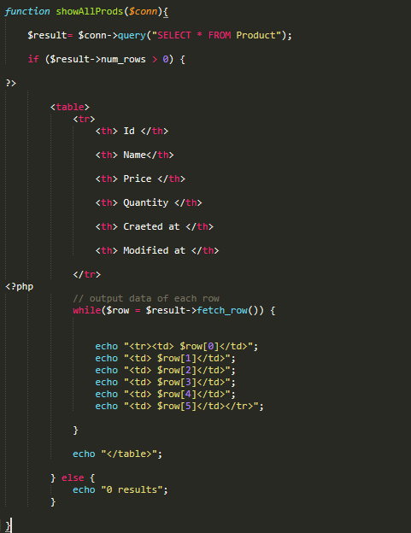
Retrieving records in to an indexed array
The $result->fetch_row() function returns the fields in the current row of a result set into an indexed array and moves the result pointer to the next row
The $result->fetch_assoc()function returns the fields into an associate array and uses each field name as the array key.

Slide 18
Exercise – 20 mint
Retrieve the data from the table using fetch_assoc()

Slide 19

Accessing query result information
The $result->num_rows function returns the number of rows in a query result
The $result->field_count function returns the number of fields in a query result

Slide 20
PHP MySQL Prepared Statements
// prepare and bind $stmt = $conn->prepare("INSERT INTO MyGuests (firstname, lastname, email) VALUES (?, ?, ?)"); $stmt->bind_param("sss", $firstname, $lastname, $email); // set parameters and execute $firstname = "John"; $lastname = "Doe"; $email = "john@example.com"; $stmt->execute(); $firstname = "Mary"; $lastname = "Moe"; $email = "mary@example.com"; $stmt->execute(); $firstname = "Julie"; $lastname = "Dooley"; $email = "julie@example.com"; $stmt->execute(); echo "New records created successfully";
Prepared Statements in MySQLi
The argument may be one of four types:
i - integer
d - double
s - string
b - BLOB

Slide 21
Lab Task
Consider a scenario of your choice and implement CRUD operation in it along with the interfaces (use bootstrap and prepared statement)
Loads data from a text file into a MYSQL database using LOAD DATA command.

